Slide 1


Capital Bikeshare Study
Bruno Bernardo Nascimento dos Santos
Code Academy Berlin
June 24th, 2021

Slide 2
Topics at a Glance
1-) Understanding our Dataset and Business
2-) First Insights of the Business with Plots
3-) Complex events – TimeSeries study
4-) Predicting the Total count of users – Comparison
5-) Can we implement KPIs ?
6-) Conclusion and suggestions

Slide 3
1-) Understanding our Dataset and Business
Capital Bikeshare launched in Sep 2010 (DC Area)
Member Type
Registered - member (Annual Member, 30-Day Member or Day Key Member)
Casual - rider (Single Trip, 24-Hour Pass, 3-Day Pass or 5-Day Pass)
Single Trip - $2
24-Hour Pass - $8 / day
3-Day Pass – $17
Annual Membership - $7 / month

Slide 4

1-) Understanding our Dataset and Business
Do ridership trends vary based on type of membership?
YES
The large T-Value of 97.81 tells us there is a significant difference between the two groups. The very small P-Value of 0 tells us this is unlikely to have occurred by chance.

Slide 5
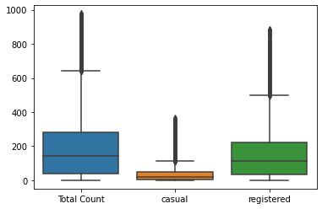
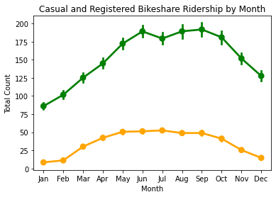
1-) Understanding our Dataset and Business
registered
casual

Slide 6
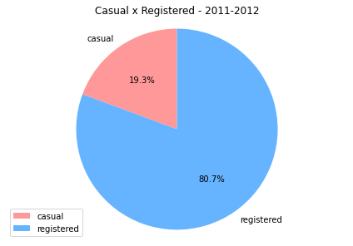
1-) Understanding our Dataset and Business Data from 2011 - 2012

Slide 7
1-) Understanding our Dataset and Business
registered
casual

Slide 8
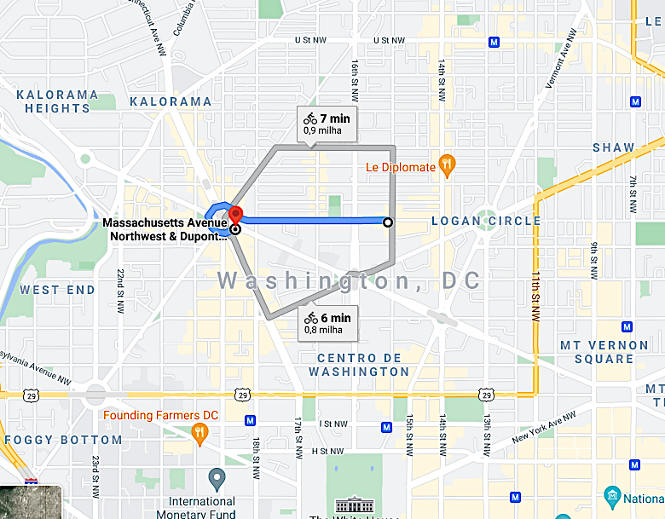
1-) Understanding our Dataset and Business
Residential
Hotel area – Luxury condos
Downtown
Most popular stations in DC:
Massachusetts Ave & Dupont Circle
P St & 15th St

Slide 9
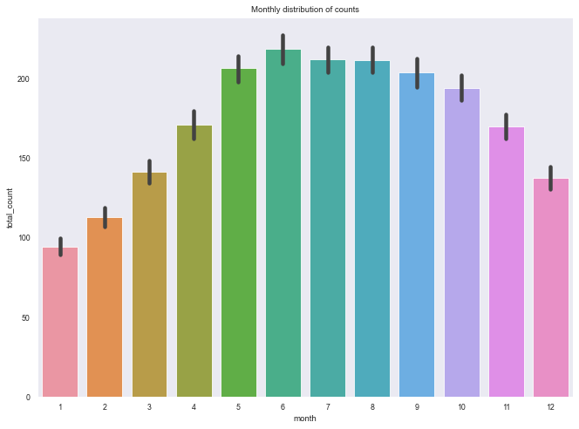
2-) First Insights of the Business with Plots

Slide 10
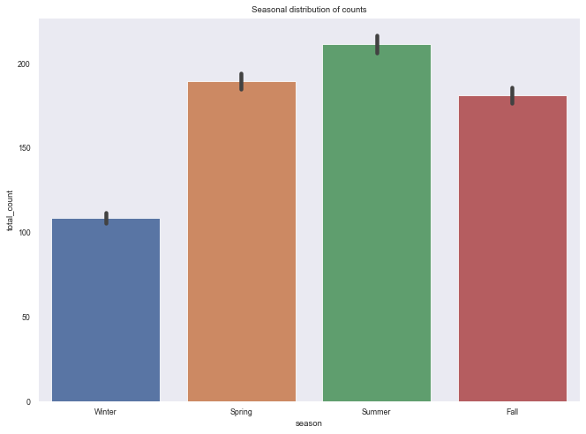
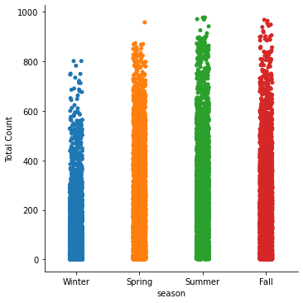
2-) First Insights of the Business with Plots
Season

Slide 11
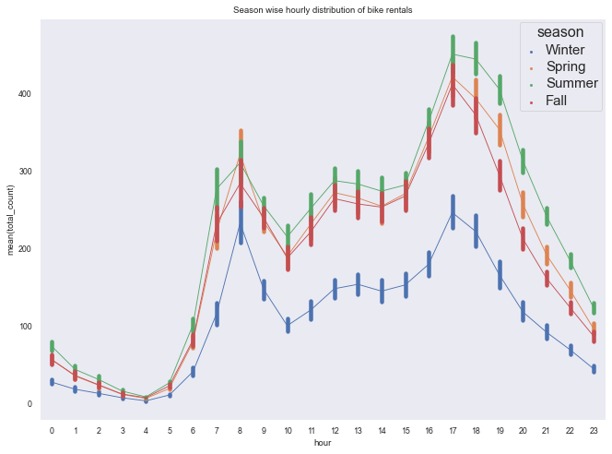
2-) First Insights of the Business with Plots
Season

Slide 12
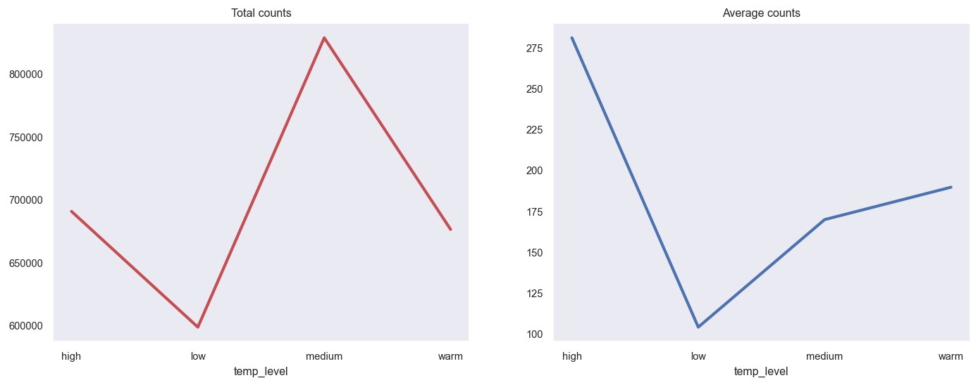
2-) First Insights of the Business with Plots
Low = < 10 Medium = > 10 & < 20 Warm = > 20 & < 25 High = > 25
Temperature Level

Slide 13
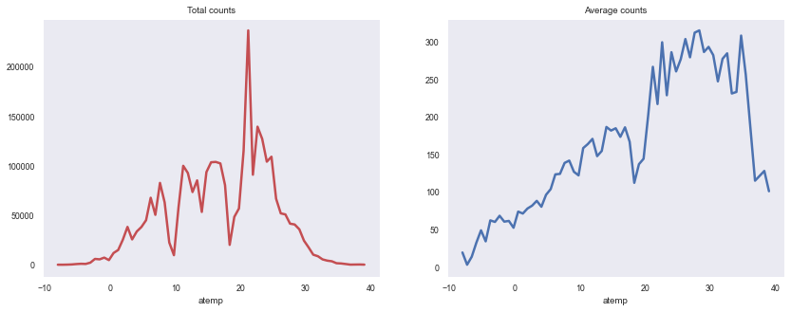
2-) First Insights of the Business with Plots
Atemp – Feeling Temperature

Slide 14
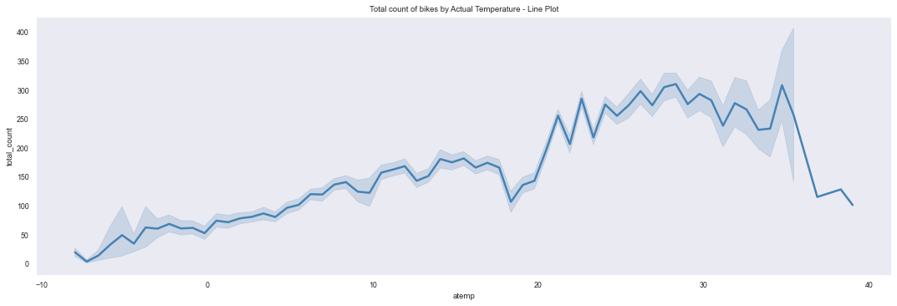
2-) First Insights of the Business with Plots
Atemp – Feeling Temperature

Slide 15
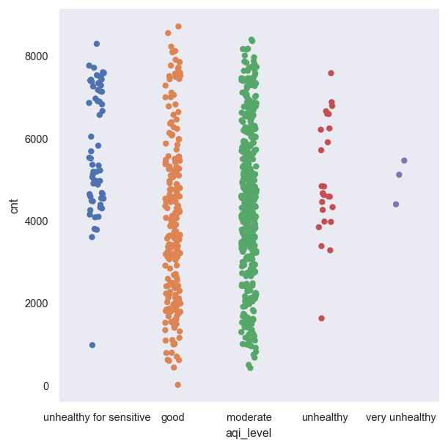
2-) First Insights of the Business with Plots
Pollution

Slide 16
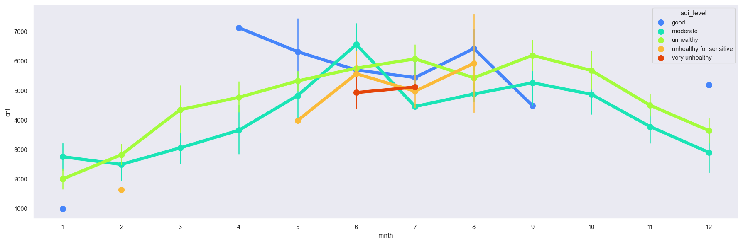
2-) First Insights of the Business with Plots
Pollution – Monthly

Slide 17
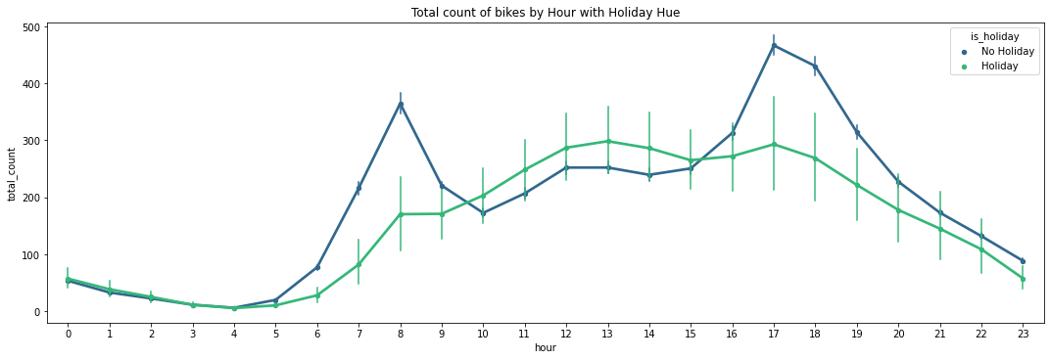
2-) First Insights of the Business with Plots
Holiday Analysis

Slide 18
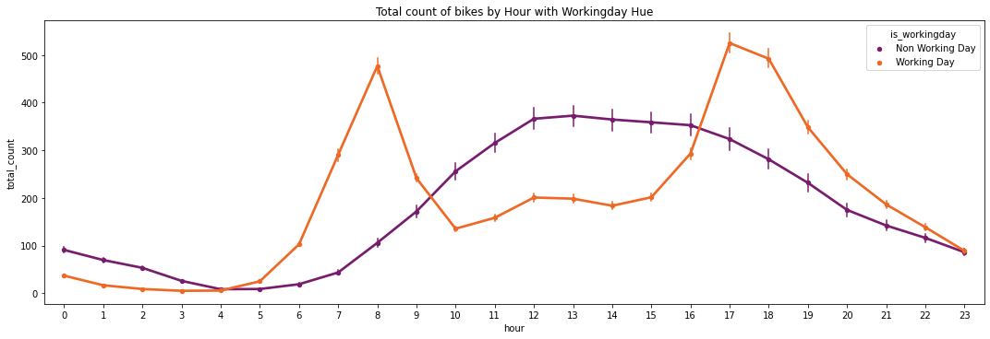
2-) First Insights of the Business with Plots
Working Day Analysis

Slide 19
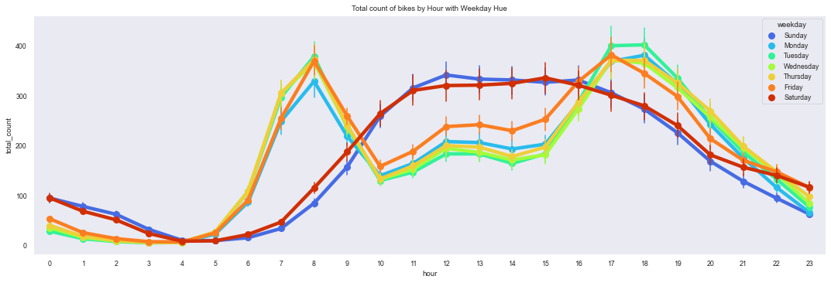
2-) First Insights of the Business with Plots
Weekdays Analysis

Slide 20
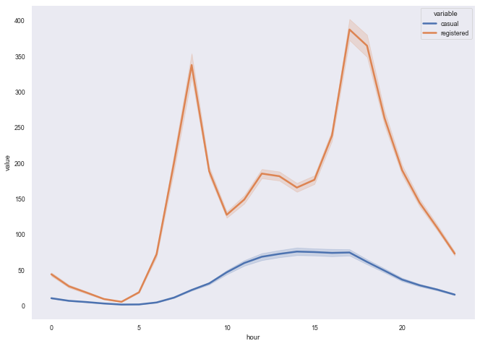
2-) First Insights of the Business with Plots
Variable – Casual and Registered Users Analysis
Hourly Variance

Slide 21
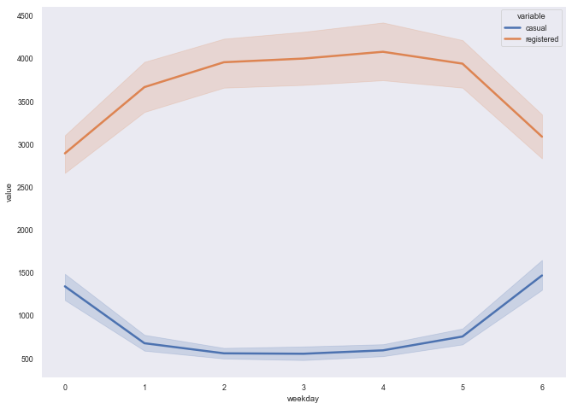
2-) First Insights of the Business with Plots
Variable – Casual and Registered Users Analysis
Weekday Variance

Slide 22
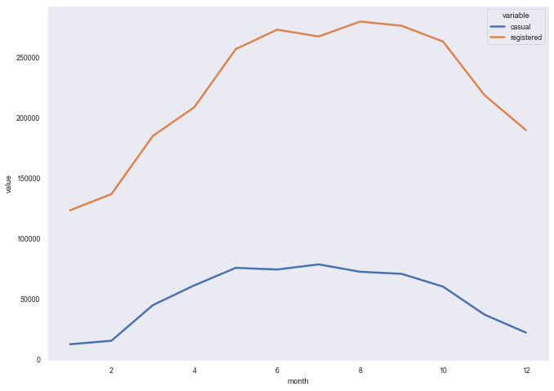
2-) First Insights of the Business with Plots
Variable – Casual and Registered Users Analysis
Monthly Variance

Slide 23
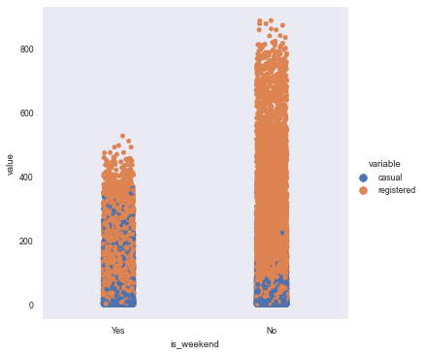
2-) First Insights of the Business with Plots
Variable – Casual and Registered Users Analysis
Weekend Variance

Slide 24
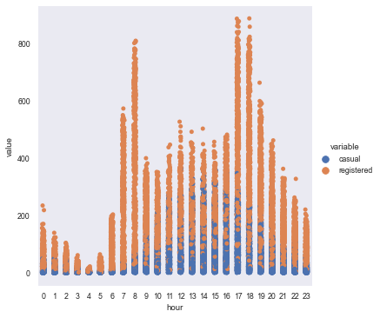
2-) First Insights of the Business with Plots
Variable – Casual and Registered Users Analysis
Washington DC First Rush Hour – 5am to 9am
Increase of both users between 5am and 9am
Washington DC Second Rush Hour – 5pm to 9am
Between 5pm and 7pm occurs the same during the second rush hour.
Increase of casual users between 8am and 8pm, with higher peaks between 1pm and 6pm

Slide 25
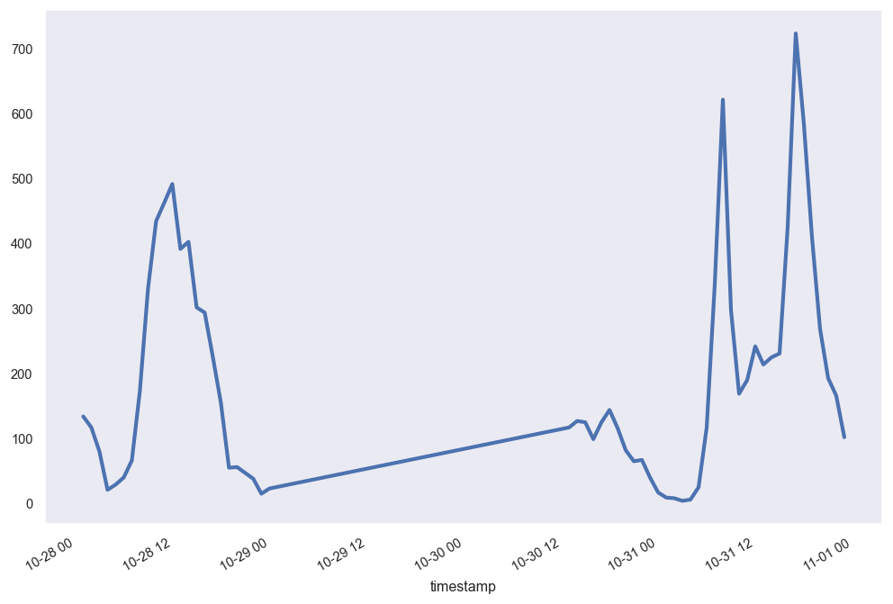
3-) Complex events – TimeSeries study
TimeSeries function to isolate data for the day of passage of Storm Sandy in October 29-30, 2012. The number of bicycle rentals continued to grow during typical rush hours (morning and afternoon), although in smaller numbers.

Slide 26
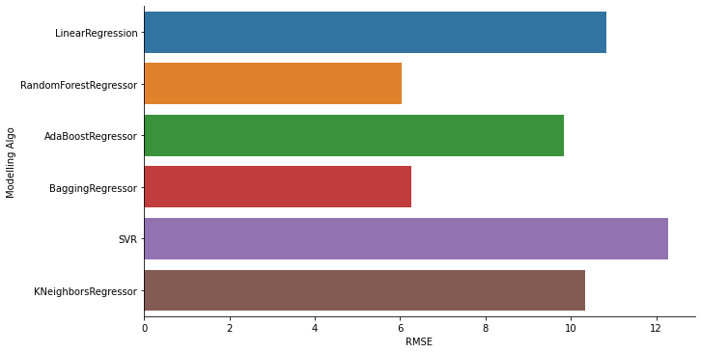
4-) Predicting the Total count of users – Comparison
Root Mean Squared Error (RMSE) – It has a drastic effect of outliers on its values

Slide 27
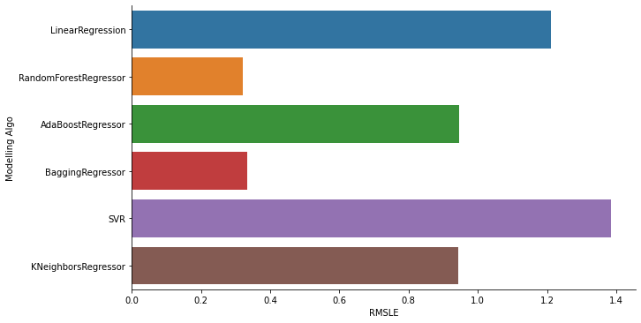
4-) Predicting the Total count of users – Comparison
Root Mean Squared Logarithmic Error (RMSLE) - Only consider the relative error between Predicted and the actual value neglecting the scale of data

Slide 28
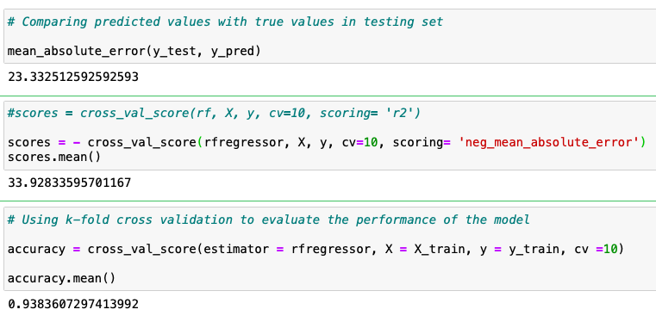
4-) Predicting the Total count of users – Comparison
Metrics – Random Forest Regressor

Slide 29
Yes
5-) Can we implement KPIs ?
evaluate the performance of Capital Bikeshare through KPIs
Key performance indicators were based on existing metrics and parameters gathered
KPIs
KPI | METRIC
Membership system management | Yearly difference between the percentage of registered users and casual users
System usage | Monthly trips per registered and casual users
Seasonality | Percentage of bicycle use per season
Performance evaluation
Results

Slide 30
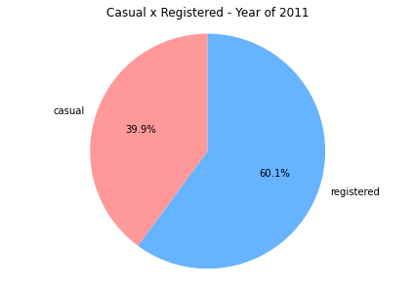
5-) Can we implement KPIs ?
Membership system management

Slide 31
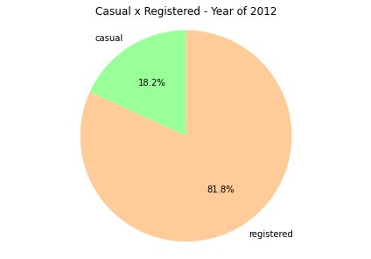
5-) Can we implement KPIs ?
Membership system management
Performance evaluation: 21.7% increase in the number of registered users

Slide 32
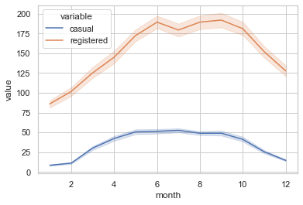
5-) Can we implement KPIs ?
System usage
Performance Evaluation: Reduction in the number of bicycles in the winter months (between October and January), coinciding with important dates of the year such as Christmas and New Year holidays.

Slide 33
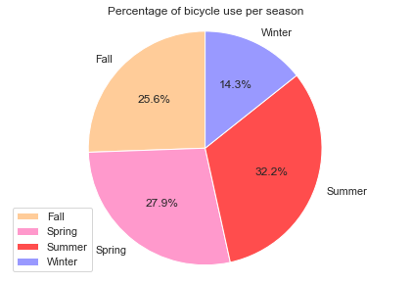
5-) Can we implement KPIs ?
Seasonality
Performance Evaluation: Low percentage of bike use in Winter season

Slide 34
6-) Conclusion and suggestions
Number of registered users is greater than casual users.
The most popular pick-up and delivery stations for bicycles were Massachusetts Ave & Dupont Circle and P St & 15th St.
May, June, July, August and September are the months with the highest number of bike rentals.
Summer is the season with the highest bike rentals, followed by spring and autumn, with decrease in winter.
Pollution levels negatively affect bike rental, as do weather conditions and thermal sensation (too cold or too hot).
Registered users rent more bikes on working days, with peak hours for commuting, and casual users use more bikes on weekends.

Slide 35
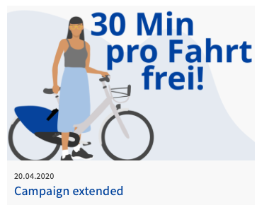
6-) Conclusion and suggestions
Can we improve the approach with casual users?
An alternative would be to offer a free run up to a limited time for the use or a promotion like what happened in Berlin.

Slide 36
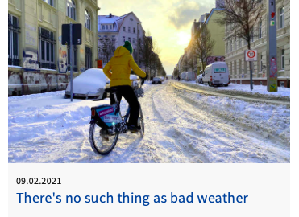
6-) Conclusion and suggestions
Are users prepared for adversity of the climate?
Users may not have the necessary technical knowledge or encouragement to acquire specific clothing to use bicycles in low temperatures. A partnership with a brand/store could be a good solution to encourage people to move more in winter.

Slide 37
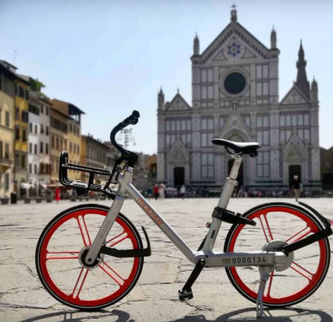
6-) Conclusion and suggestions
Are our registered users running less around the city on weekends?
Campaigns to discover tourist spots in the city by bike is a good solution.

Slide 38
Suggestions for Data Collection
Pricing
Information about which membership or daily ticket was used by ride.
Empty station record
Information about which station was empty, showing date and time.

Slide 39
Thank you !

Slide 40
References
UCI Citation Request:
Fanaee-T, Hadi, and Gama, Joao, 'Event labeling combining ensemble detectors and background knowledge', Progress in Artificial Intelligence (2013): pp. 1-15, Springer Berlin Heidelberg, [Web Link]. @article{ year={2013}, issn={2192-6352}, journal={Progress in Artificial Intelligence}, doi={10.1007/s13748-013-0040-3}, title={Event labeling combining ensemble detectors and background knowledge}, url={[Web Link]}, publisher={Springer Berlin Heidelberg}, keywords={Event labeling; Event detection; Ensemble learning; Background knowledge}, author={Fanaee-T, Hadi and Gama, Joao}, pages={1-15} }
LMS – CAB
https://www.capitalbikeshare.com/pricing/for-all
https://www.nextbike.de/en/berlin/news/campusbike-berlin-monatspass/
https://www.klipfolio.com/resources/articles/what-is-a-key-performance-indicator
https://ecf.com/sites/ecf.com/files/67_29AM1-1-1216-Pedro%20Pimentel%20de%20Vassimon.pdf
https://www.kaggle.com/c/bike-sharing-demand

